Slide 1
Course Outline
Intermediate Python
- Functions
- Libraries
- Exception handling
- Object-oriented programming Fundamentals

Slide 2
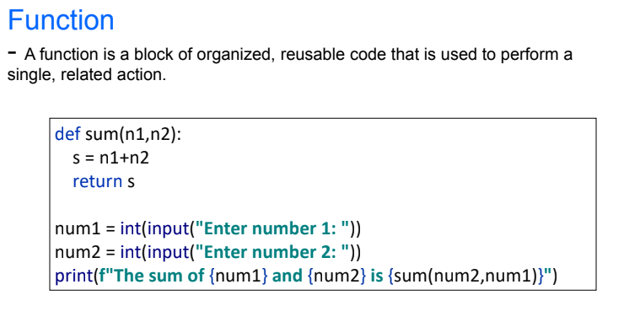
Functions

Slide 3
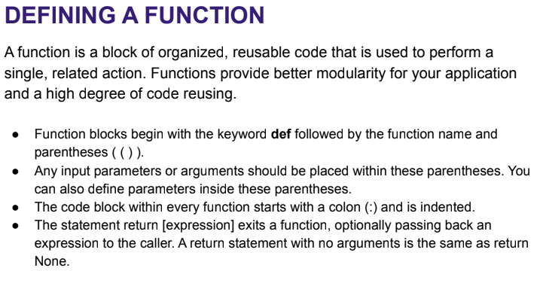
Functions

Slide 4
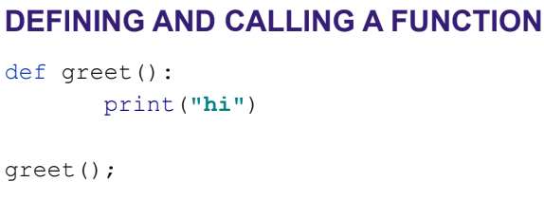
Functions

Slide 5
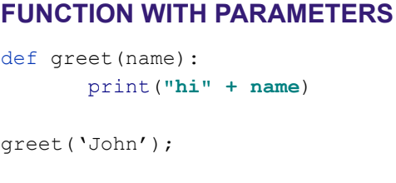
Functions

Slide 6
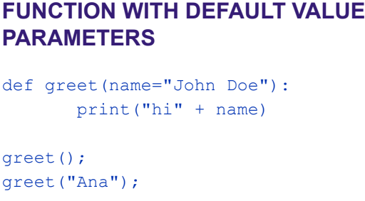
Functions

Slide 7
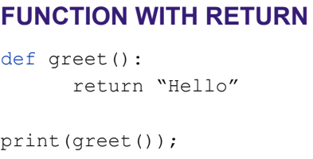
Functions

Slide 8
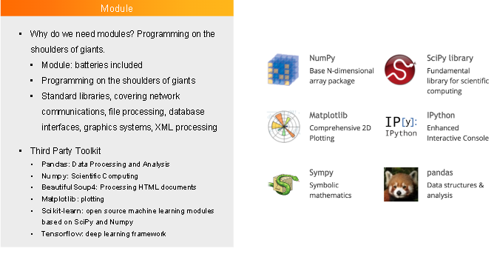
Libraries/Modules

Slide 9
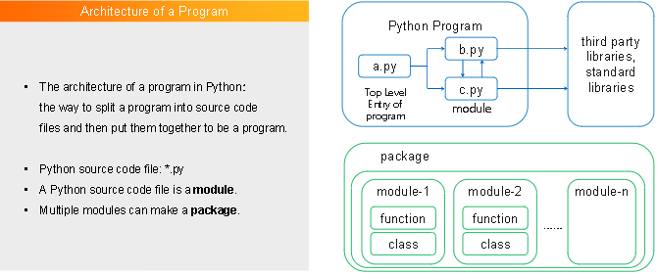
Libraries/Modules

Slide 10
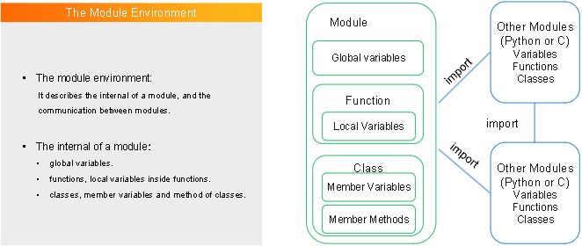
Libraries/Modules

Slide 11
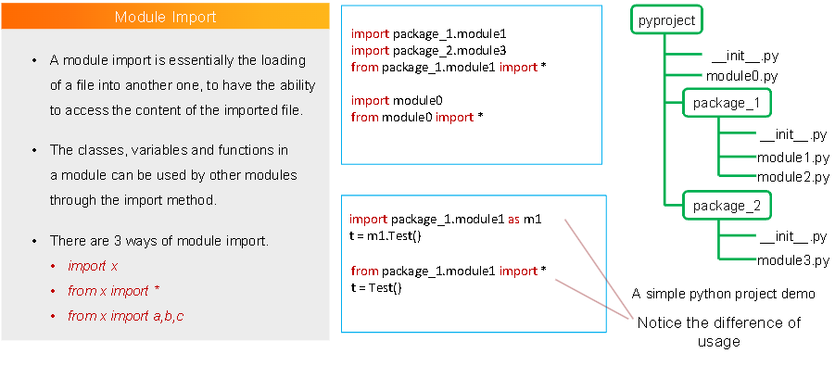
Libraries/Modules

Slide 12
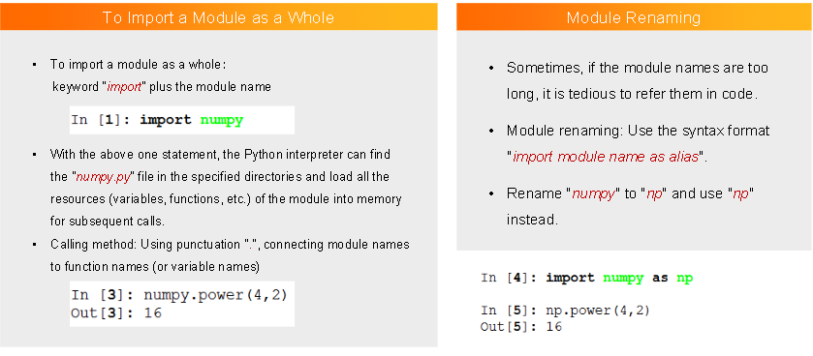
Libraries/Modules

Slide 13
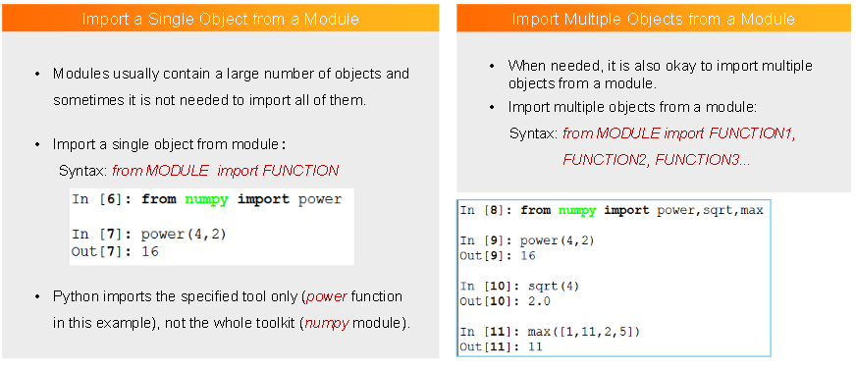
Libraries/Modules

Slide 14
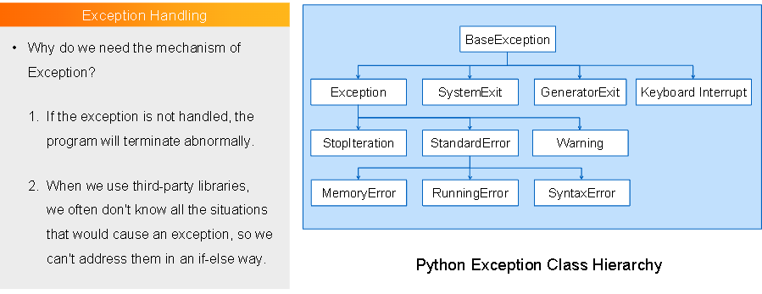
Exception Handling

Slide 15
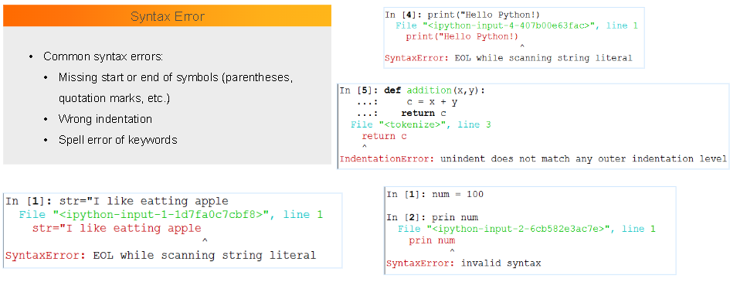
Exception Handling

Slide 16
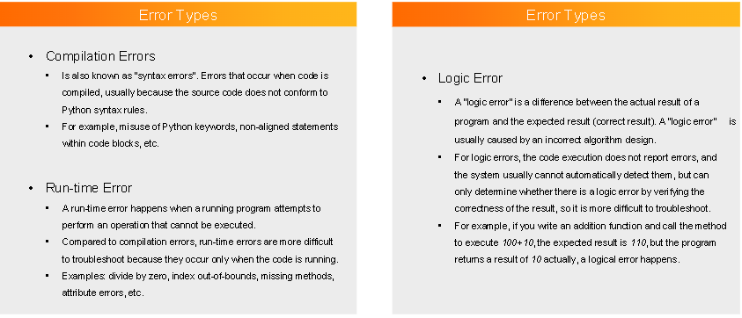
Exception Handling

Slide 17
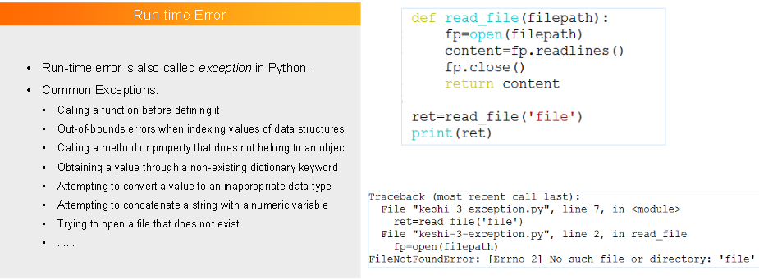
Exception Handling

Slide 18
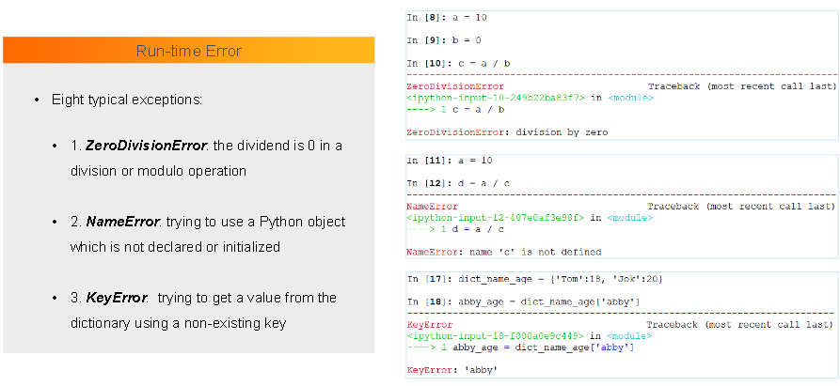
Exception Handling

Slide 19
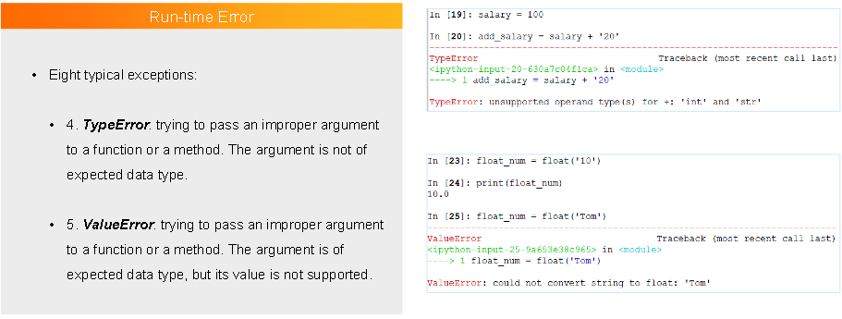
Exception Handling

Slide 20
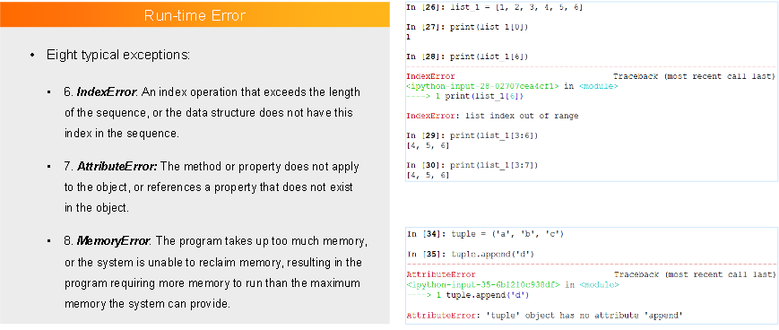
Exception Handling

Slide 21
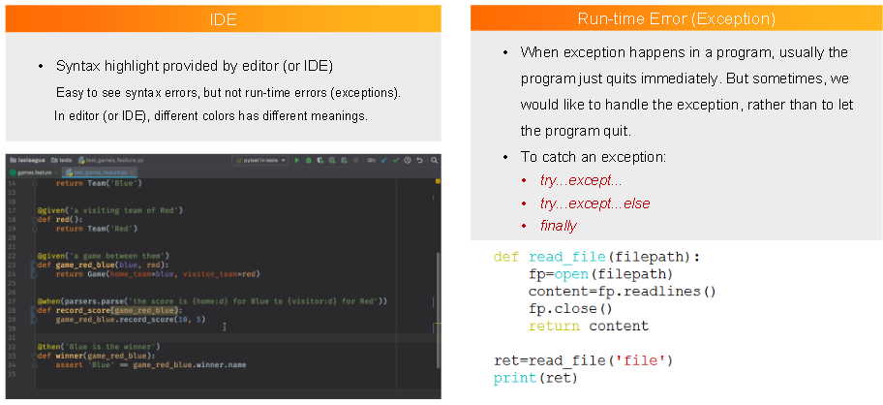
Exception Handling

Slide 22
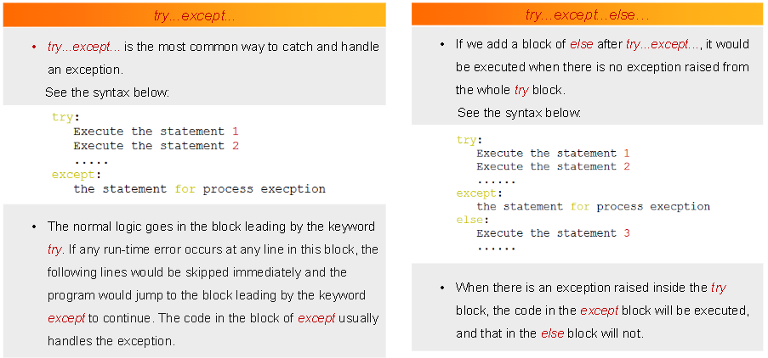
Exception Handling

Slide 23
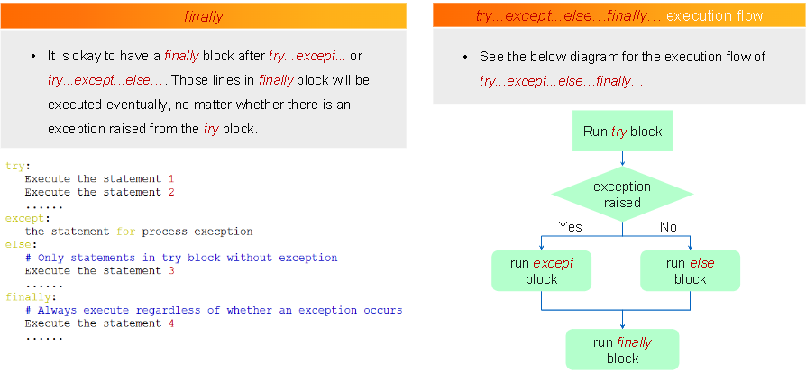
Exception Handling

Slide 24
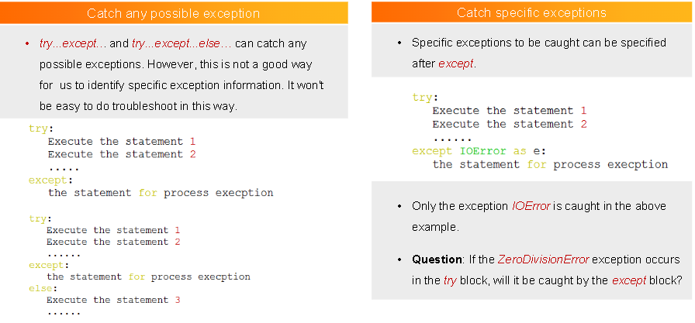
Exception Handling

Slide 25
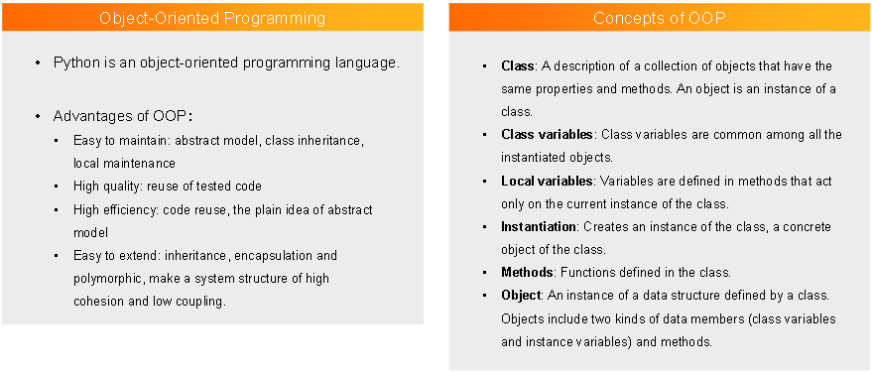
OOP Fundamentals

Slide 26
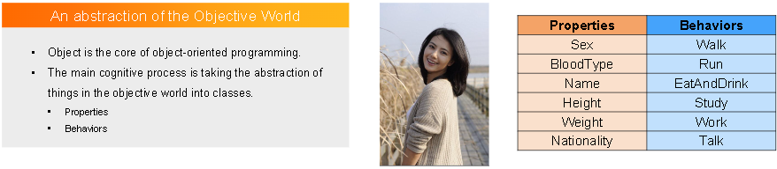
OOP Fundamentals

Slide 27
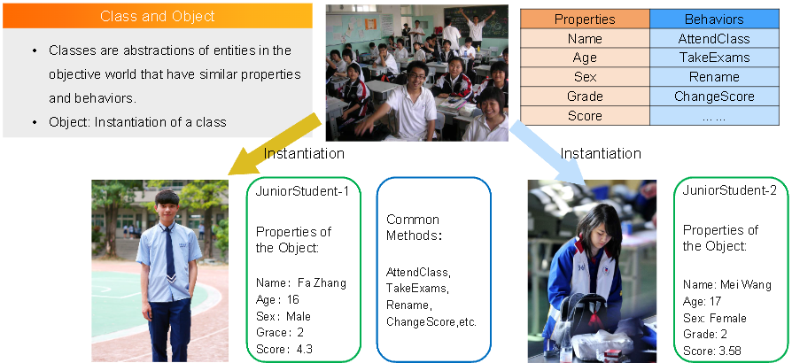
OOP Fundamentals

Slide 28
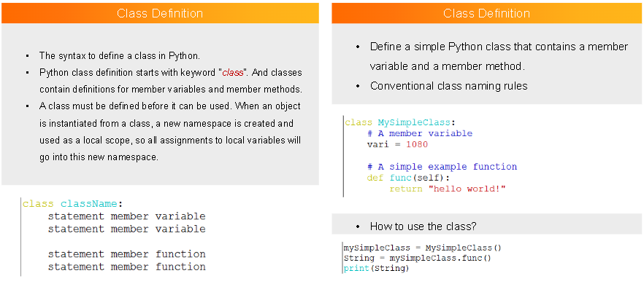
OOP Fundamentals

Slide 29
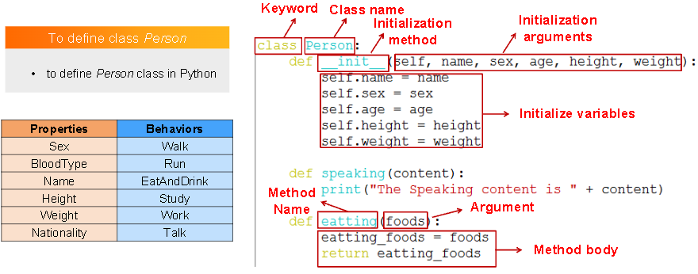
OOP Fundamentals

Slide 30
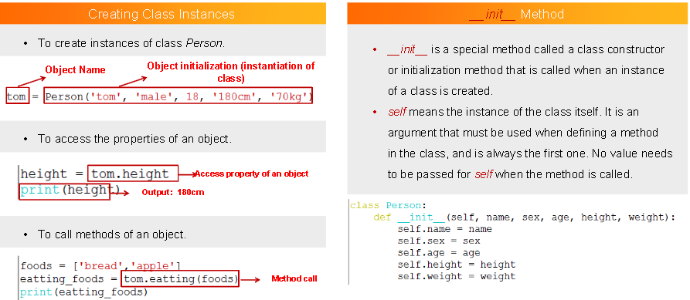
OOP Fundamentals

Slide 31
References
https://docs.python.org/3/library/functions.html - Built-in functions
https://docs.python.org/3/library/index.html - Libraries
https://docs.python.org/3/tutorial/errors.html - Errors and Exceptions
https://realpython.com/python3-object-oriented-programming/ - OOP

